Slide 1




CO 226 | DATABASE DESIGN PROJECT
SOCIAL MEDIA
PLATFORM
E/19/446 WIJERATHNA I.M.K.D.I..
E/19/436 WICKRAMASINGHE G.T.G.
E/19/309 RAMBUKWELLA H.M.W.K.G.
This Photo by Unknown Author is licensed under CC BY-NC

Slide 2

Social Media Platform
Database
Profile Management | Profile Privacy and Security | Connections Management
Storing Profile Information after Sign Up | Passwords Profile and Post Visibility | Handling Friend Requests
Post Management | User Engagement
Post Visibility | Comments and Likes

Slide 3

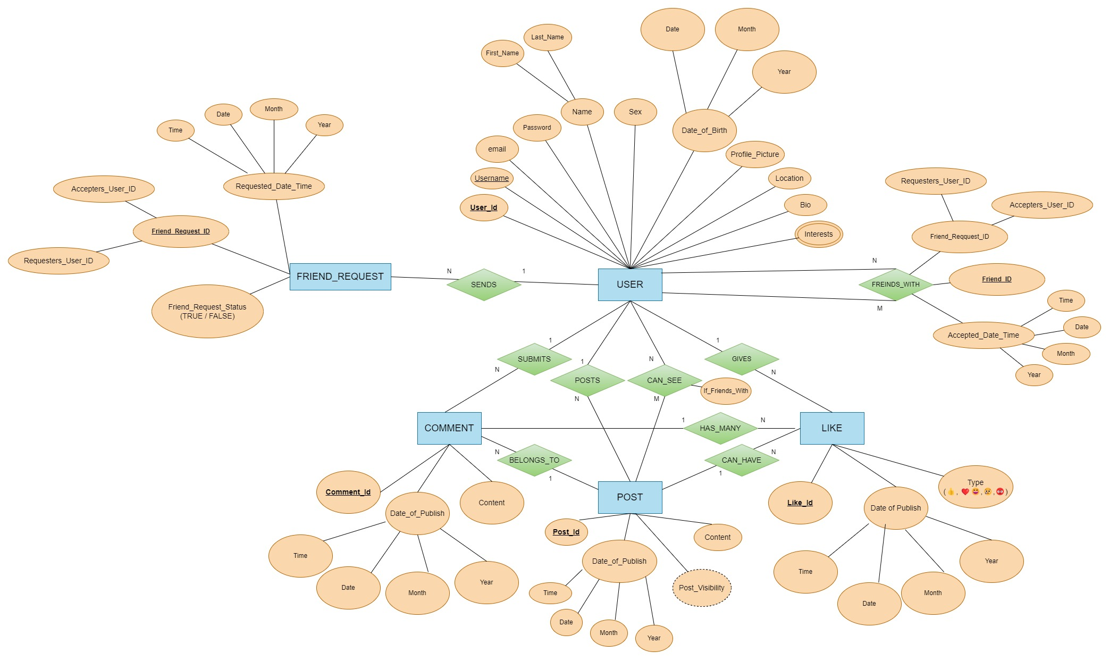
ER DIAGRAM

Slide 4
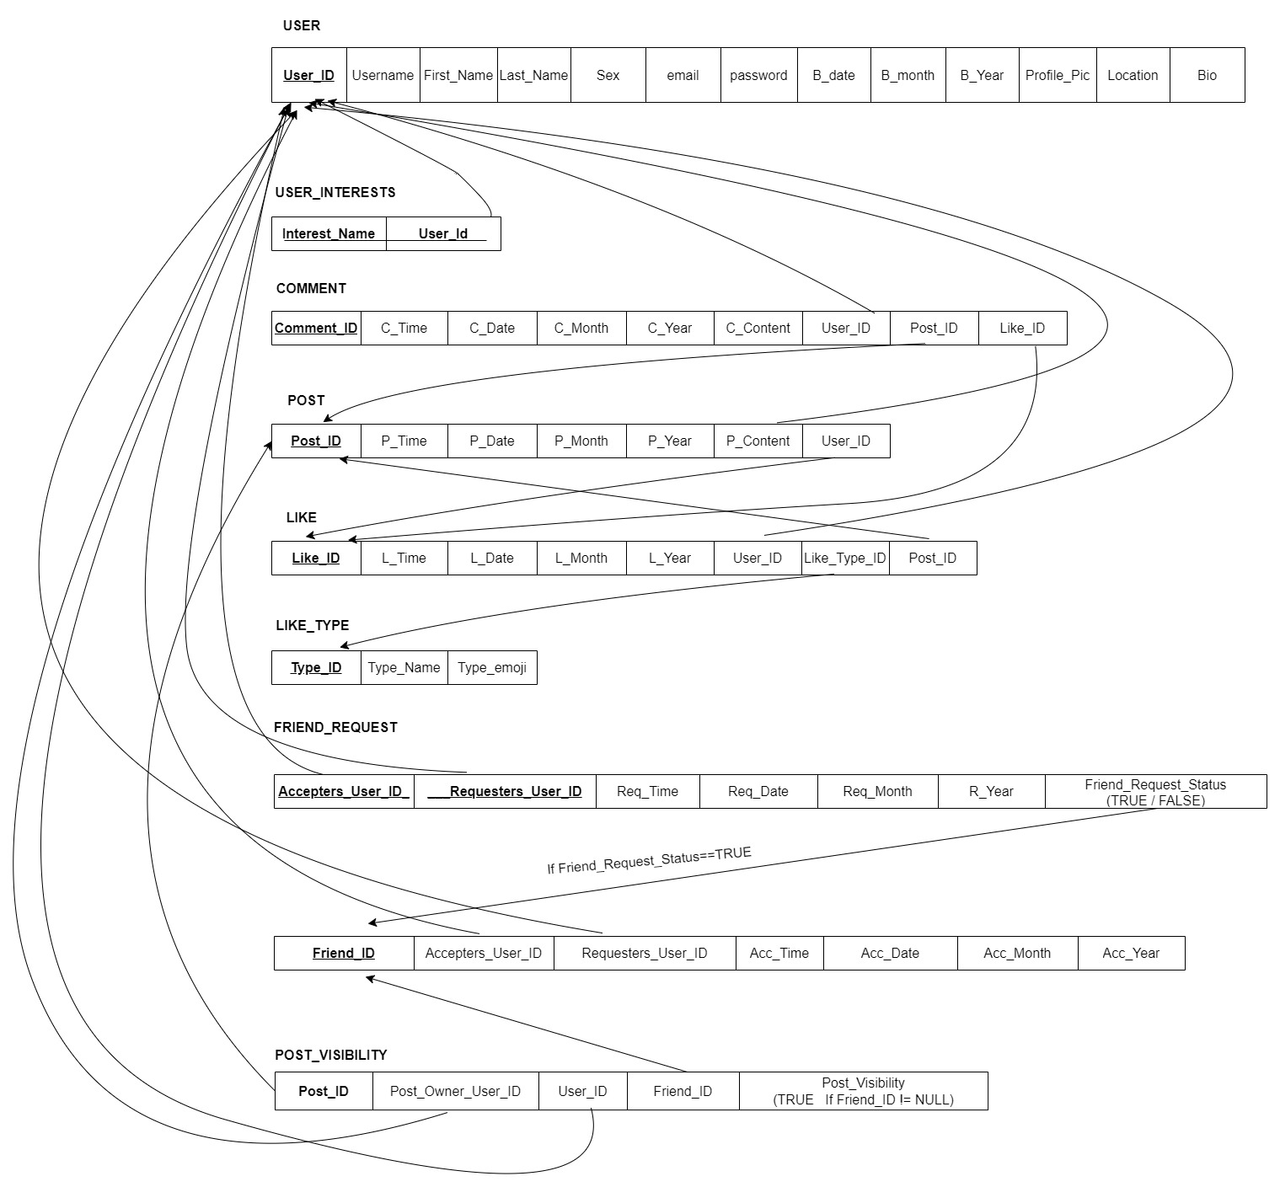
RELATIONAL MAPPING
FRIENDS_WITH

Slide 5

Thank
You!
This Photo by Unknown Author is licensed under CC BY-SA

